Slide 1
ARCHDIOCESE OF BOMBAY SMALL CHRISTIAN COMMUNITIES Quarterly Report

Slide 2
Objective of the Quarterly Report
Highlight the SCC activities in our parish and Communities / Clusters
Bring out any difficulties faced in the functioning of the SCCs in your parish
Understand the involvement of animators and families in SCCs
Adapt the reporting format to make it compatible for online reporting in future.

Slide 3
Process to be followed
Community Coordinators (CC) to submit the report to the Parish SCC Coordinator (PSC) as a soft copy/hard copy
PSC reviews all the Community reports together with Parish Priest (PP) or Priest in-charge of SCCs (P-SCC)
PSC prepares a covering letter, highlighting key points of the quarter, signed by PSC and PP/P-SCC
PSC e-mails soft copies of covering letter and all Quarterly reports to bombayscc@gmail.com

Slide 4
Reporting Schedule
The reports and the covering letter must reach bombayscc@gmail.com, as per the timeframe below:
July to September 2020 latest by October 15, 2020
October to December 2020 latest by Jan. 15, 2021
January to March 2021 latest by April 15, 2021

Slide 5
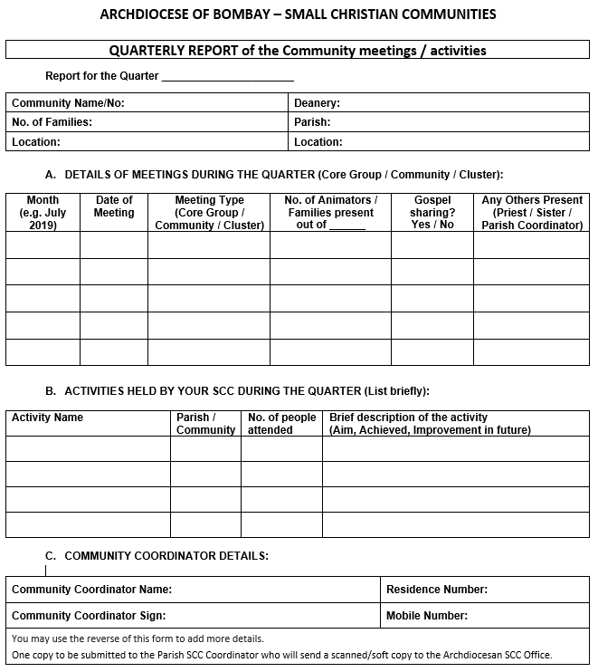
How to fill your report
Community & Parish Details
Details of your community and parish
DETAILS OF MEETINGS DURING THE QUARTER
Details of meeting held
Meeting Type – Core Group / Community / Cluster
No. of Animators / Families present out of ___
Any Others Present – Priest / Sister / Parish Coordinator
ACTIVITIES HELD BY YOUR SCC DURING THE QUARTER
Activity Name
Parish / Community
No. of people attended
Brief description of the activity – Aim, Achieved, Improvements in future
COMMUNITY COORDINATOR DETAILS:
Details of CC and sign

